Slide 1
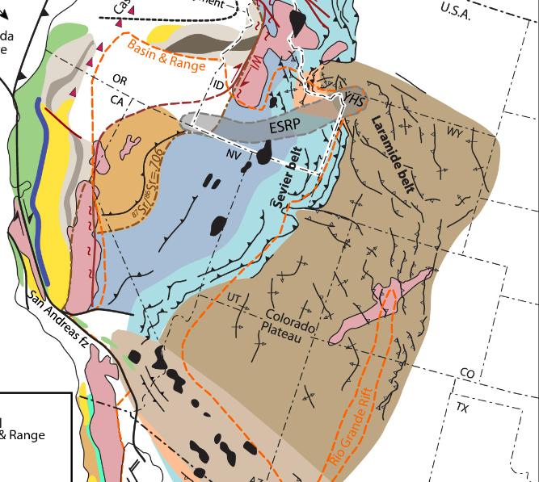
Utilizes 100’s of references to craft a narrative for the Cretaceous Sevier orogeny. It was previously poorly understood (1968)
Armstrong did a lot of the early age dating work on plutons in the Great Basin.
“It is the writer’s opinion that eventually we shall know more about the orogenic history of the Great Basin because of the faulting and volcanics, not in spite of them, for they provide exposures in the third dimension and key horizons for reconstruction”
From Idaho State University (modified from Yonkee and Weil, 2015 and Fitz Diaz et al., 2018)

Slide 2
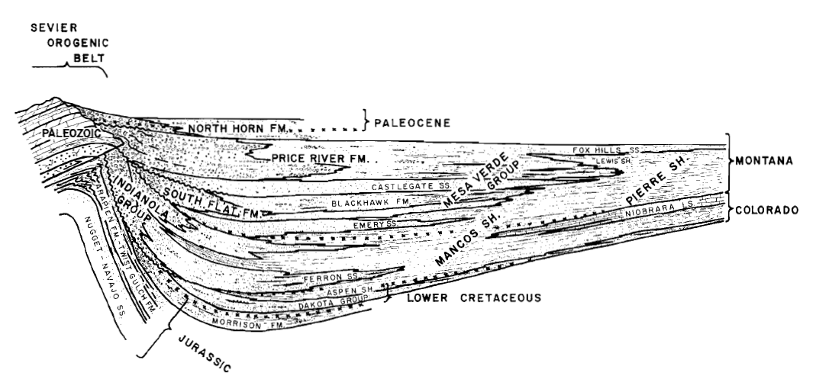
Early Evidence for the Sevier
Jurassic to Cretaceous rocks are rare and localized in eastern Nevada but are significant and thick in eastern Utah and western Colorado
Geologists had recognized that these Mesozoic clastic rocks in eastern Utah and Colorado had a western source with clasts of carbonate and siliciclastic rocks outcropping in Nevada and western Utah
Deposits coarsen to the west
Angular unconformities are more common to the west (deposition synchronous with deformation)
“Inverted” clast provenance – clast ages get older as sediment gets younger (progressive erosion of thrust sheet)
From Idaho State University (modified from Yonkee and Weil, 2015 and Fitz Diaz et al., 2018)

Slide 3
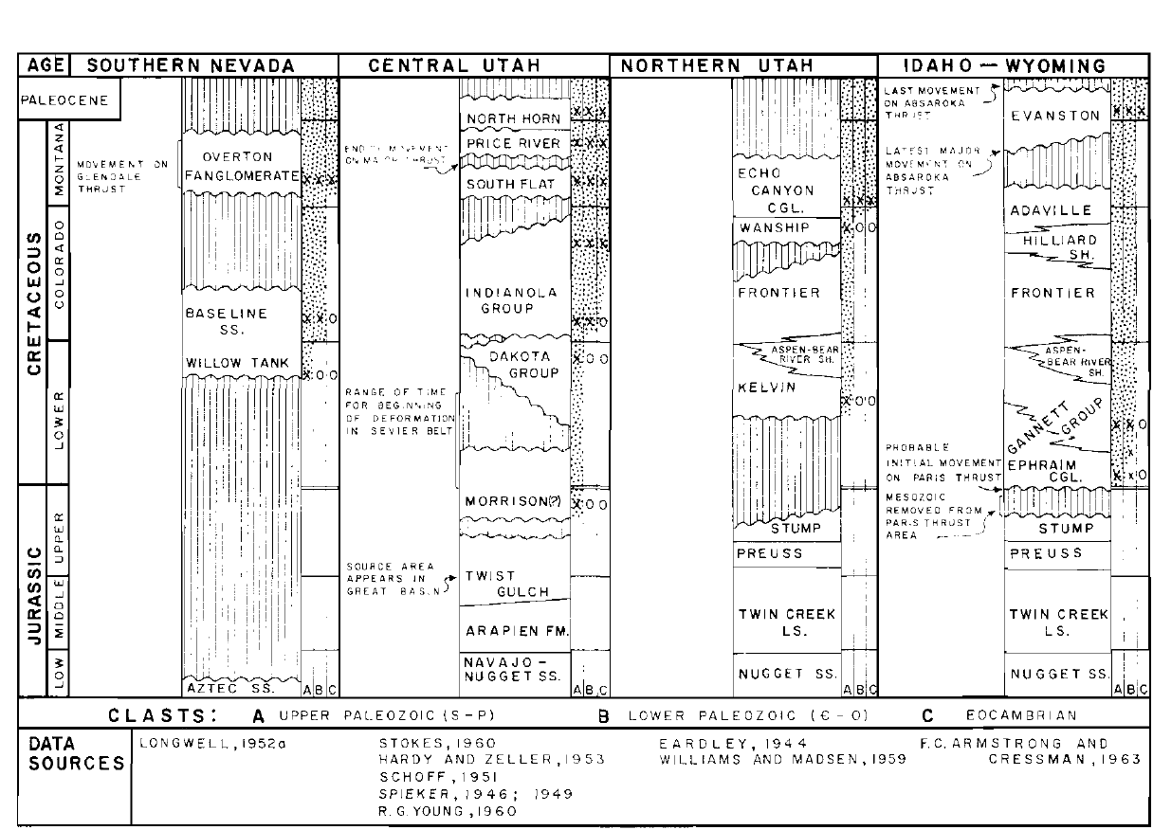
“Inverted” Clast Provenance

Slide 4
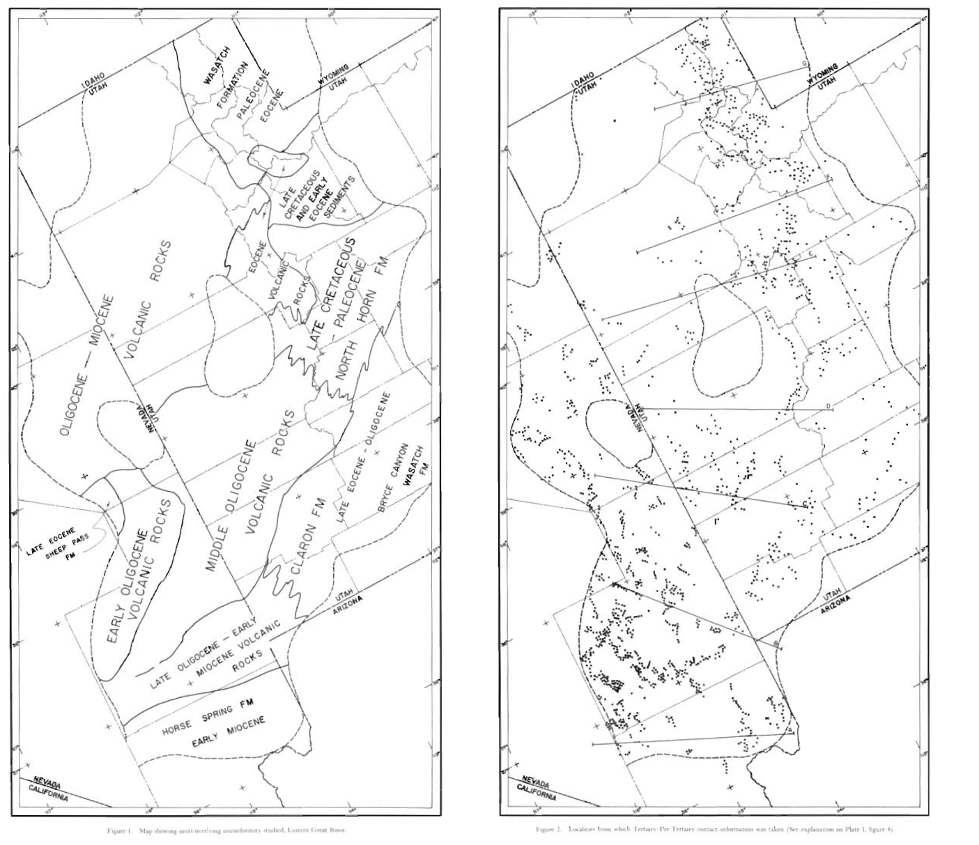
Armstrong’s Method
Armstrong does palinspastic reconstruction
Data points are elevation, bedding, and lithology below the Tertiary unconformity
Corrects for rotation of volcanics (assumes they were originally flat-lying)
Corrects for normal faults

Slide 5
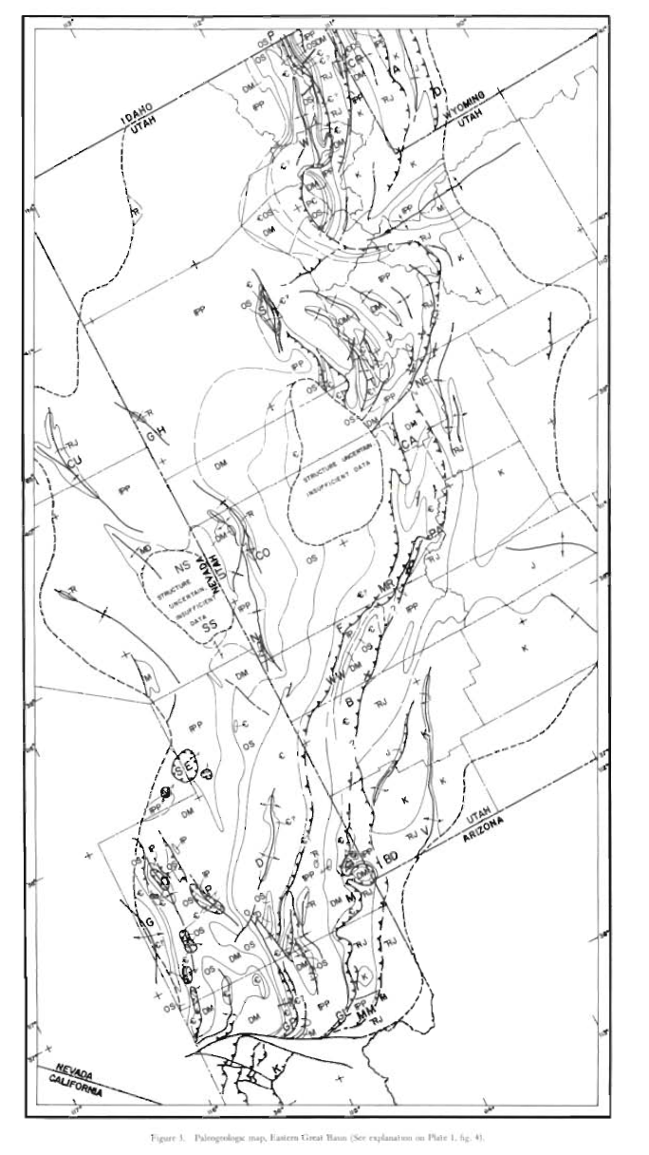
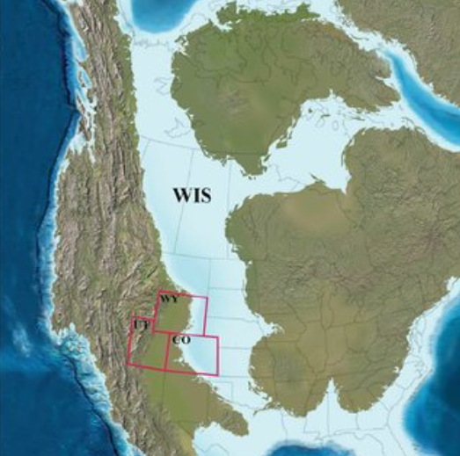
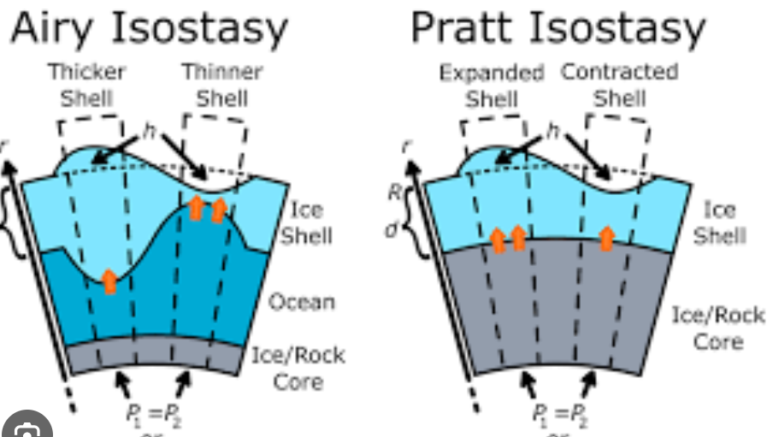
Results
The Sevier event is thought to have influenced the formation of the Western Interior Seaway
Isostatic Model
From Steele et al (2017) WIS at 75 Ma
The Sevier is now considered a classic example of thin-skinned thrusting. Thin-skinned thrusting is marked by low-angle basal decollements formed in shaly (typically) sedimentary rocks above the crystalline basement. In contrast, thick-skinned thrusting is at higher-angles and involves crystalline basement.

Slide 6
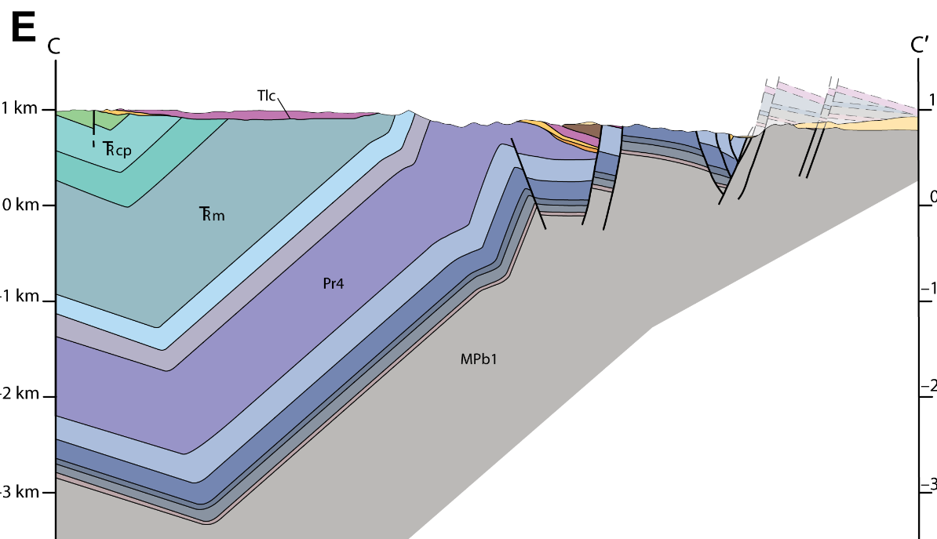
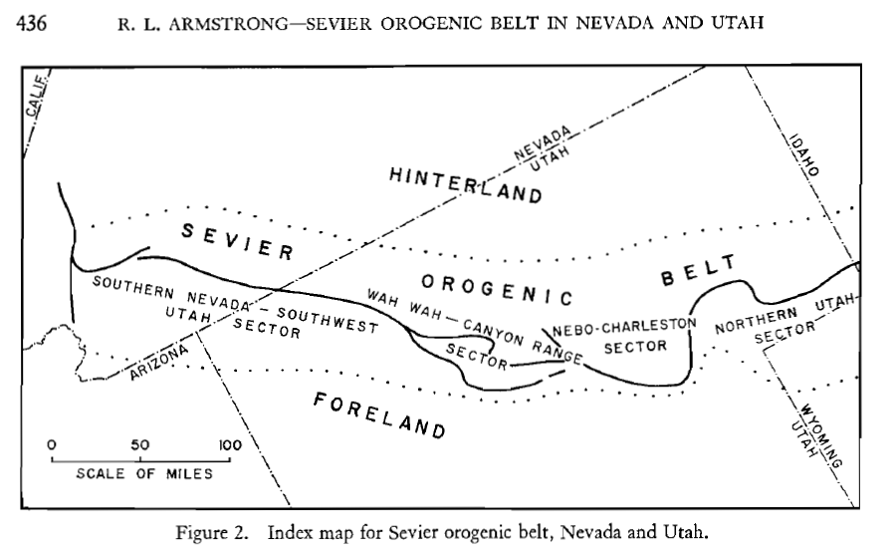
Sevier Examples: Southern Nevada – Southwest Utah Sector
In the Mormon Mountains in Nevada, a Tertiary detachment fault is interpreted to have exploited the preexisting Sevier structures.
Reconstructed NNW-N fold related to Sevier event at the beginning of Tertiary deposition
Reconstructed interpretation of detachment exploiting Sevier thrust
Cross section now
Swanson and Wernicke (2017)

Slide 7
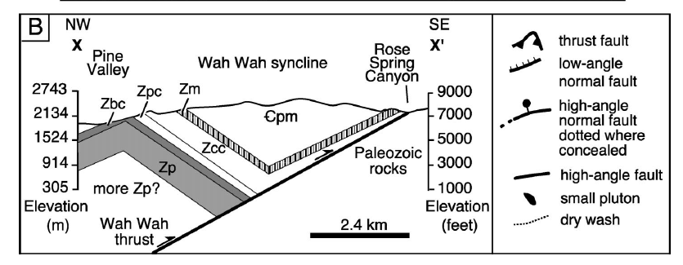
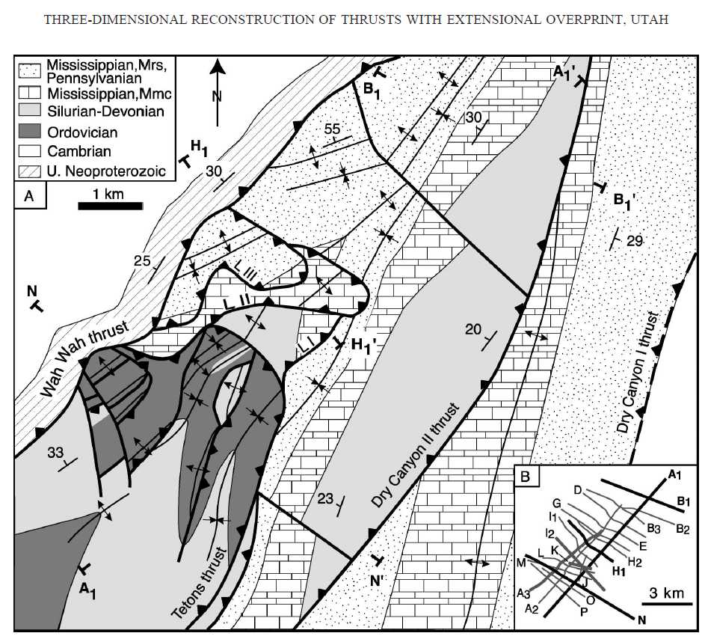
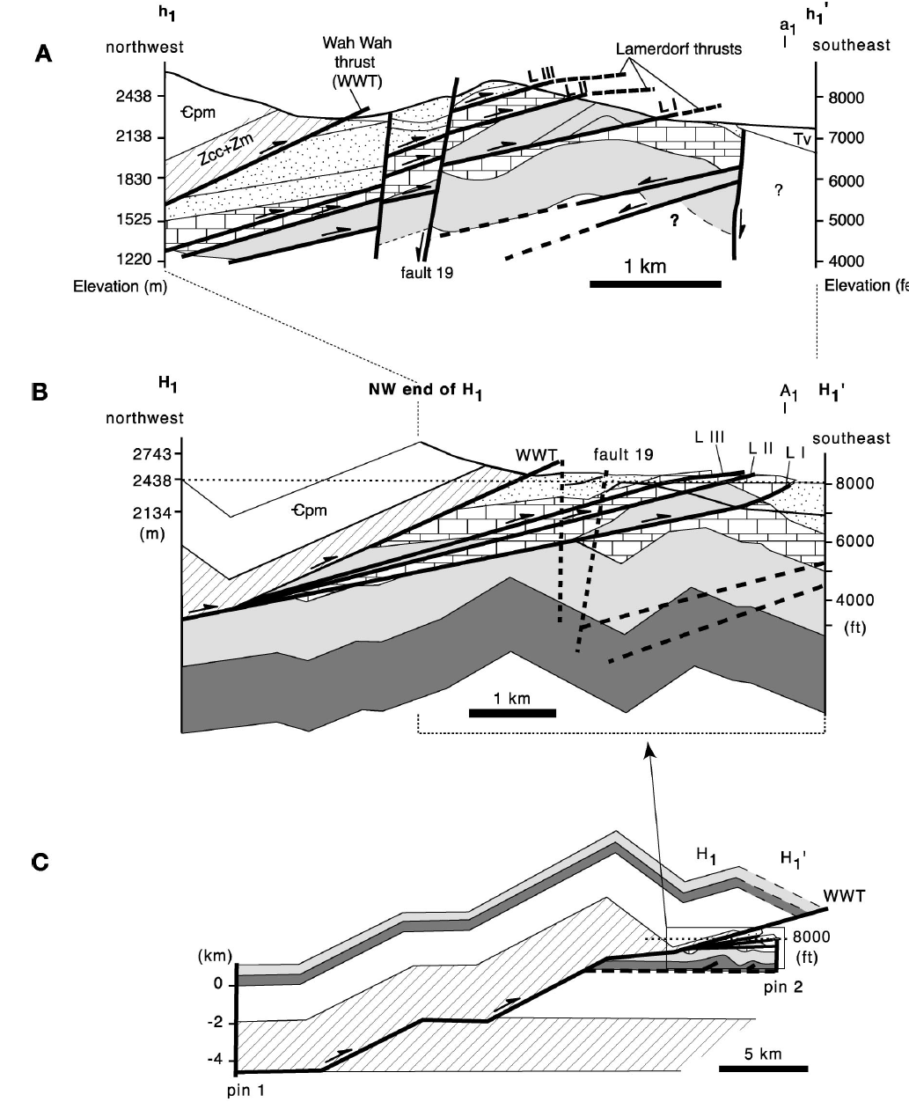
Sevier Examples: Wah-Wah – Canyon Range Sector
Simple cross section of Wah-Wahs
In the Wah-Wah range in Utah, NE oriented Sevier thrusts are related to NE trending folds
Paleo-reconstructed map showing Sevier thrusts and folds
Thrusting, imbricate thrusting, and extensional dissection
Friedrich and Bartley (2003)

Slide 8
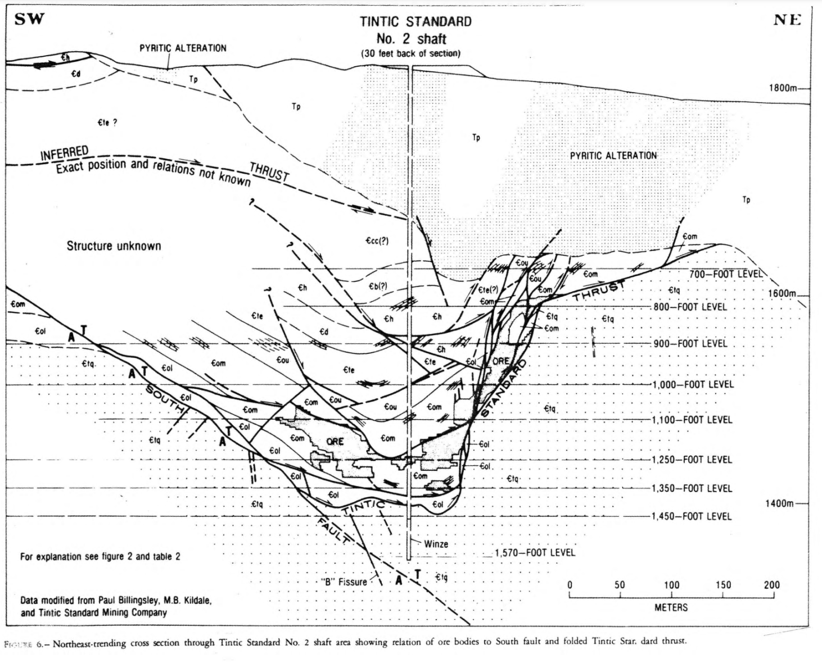
Sevier Examples: Nebo-Charleston Sector
In the Tintic district in Eureka, UT, north to northeast trending folds are present and are related to west-dipping thrust faults
Tintic is west of the frontal Sevier thrusts
Morris and Mogenson

Slide 9
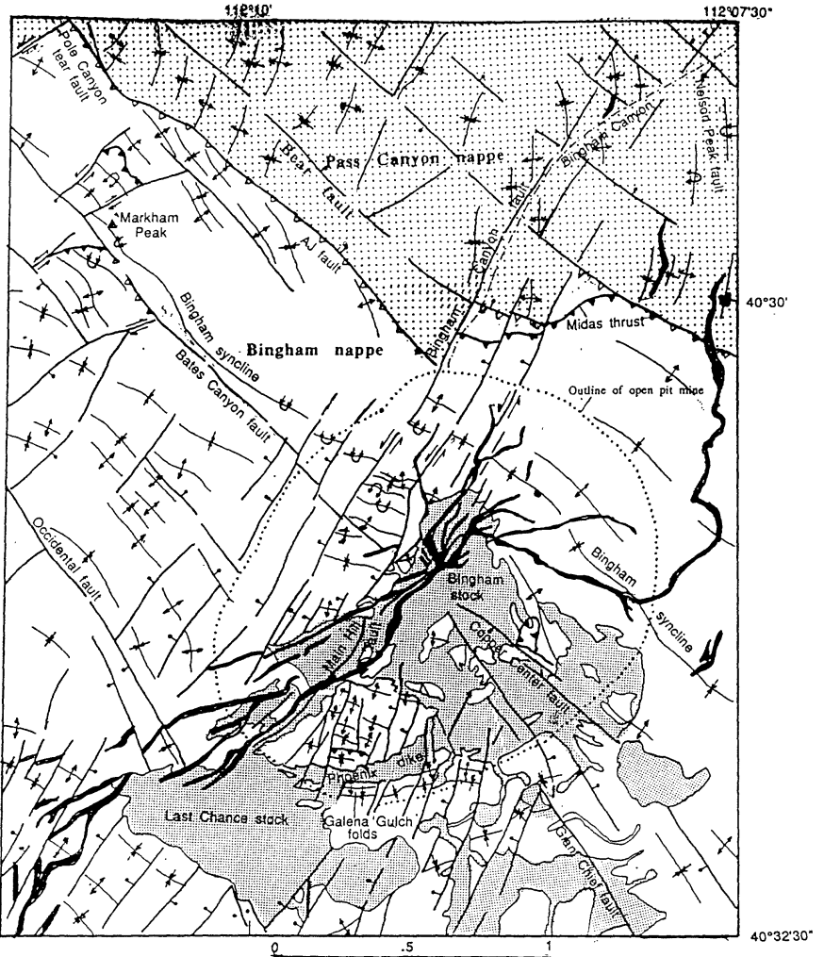
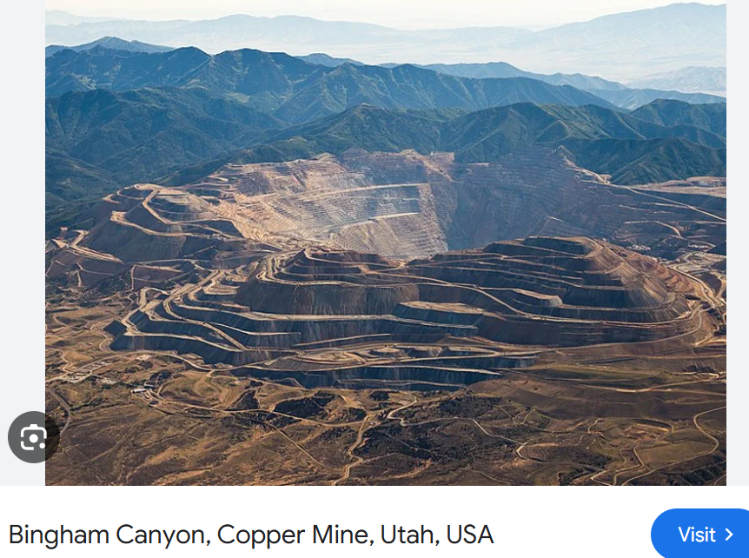
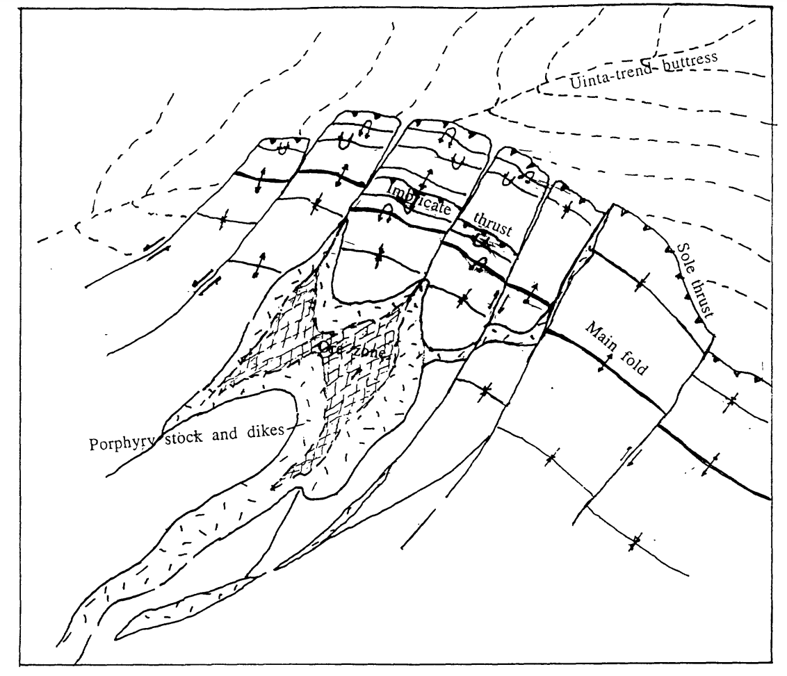
Sevier Examples: Northern Utah Sector
In the Oquirrh Mountains SW of Salt Lake City, Utah, the Sevier belt bends NW and is related to NW folds and faults. Significant mining districts.
Tooker (1998)

Slide 10
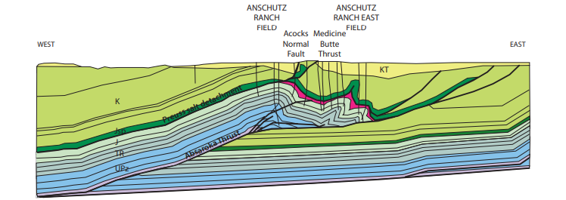
Amounts of Displacement/Shorterning
40-60 miles of offset is estimated by Armstrong
For a well-studied area in NE Utah and SW Wyoming, >150 km is indicated resulting in 50% shortening (Peyton, Constenius, and Decelles (2011)
Width of section before shortening
Width of crust after shortening

Slide 11
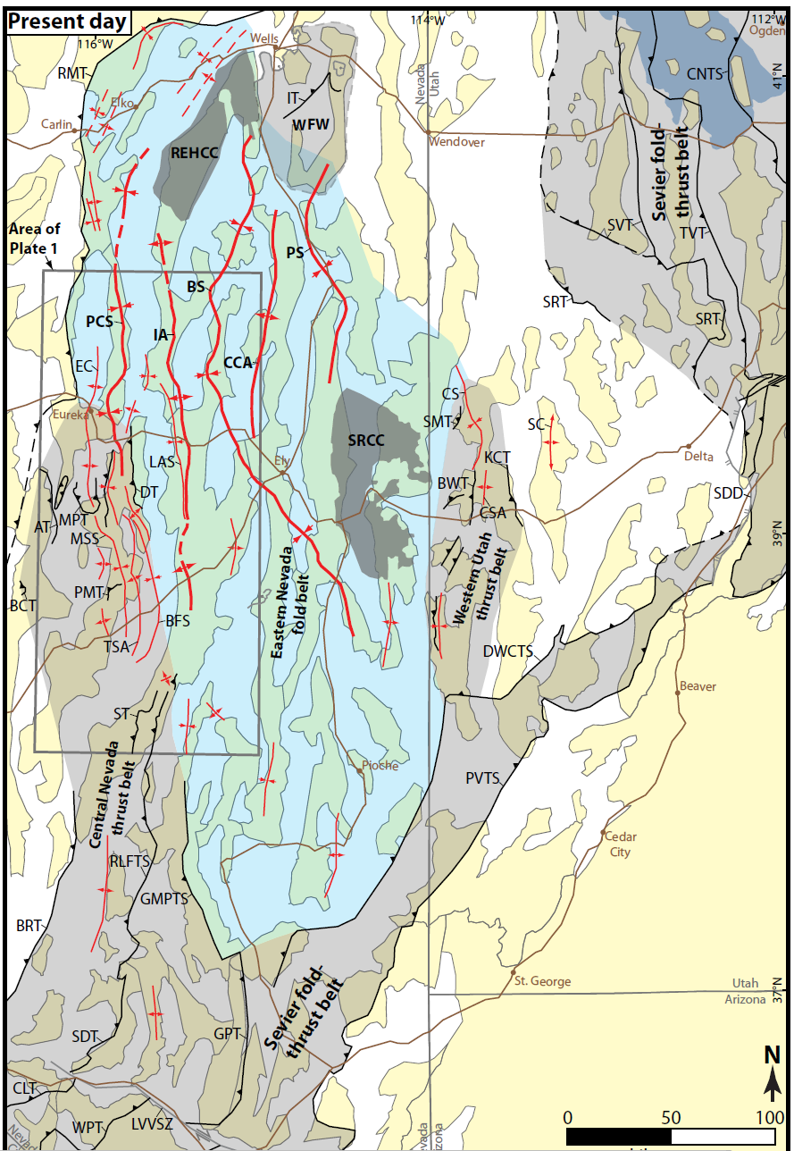
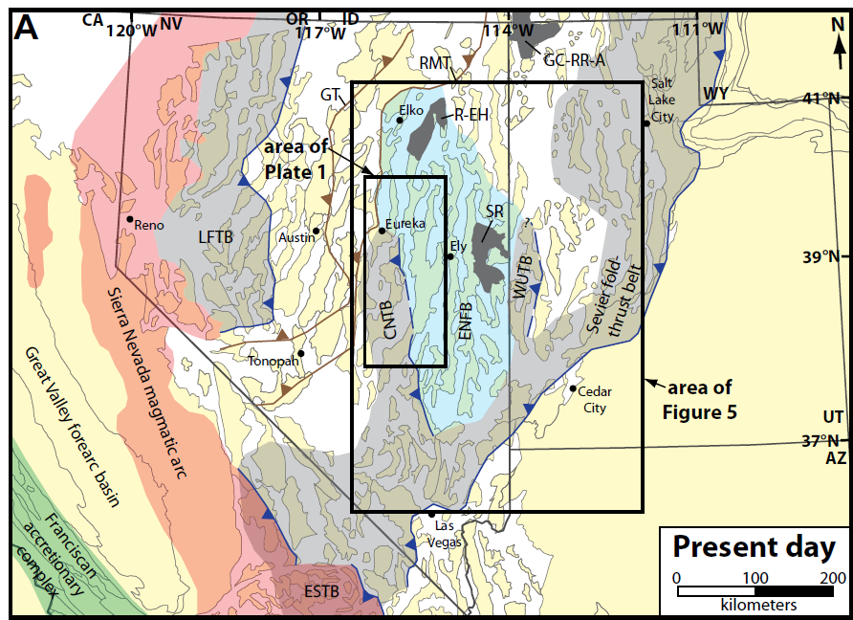
Sevier Hinterland
Armstrong notes that west of the Sevier thrust belt in Eastern Nevada is an area of broad open folds (Eastern Nevada Fold Belt of Long)
From Long (2015)

Slide 12
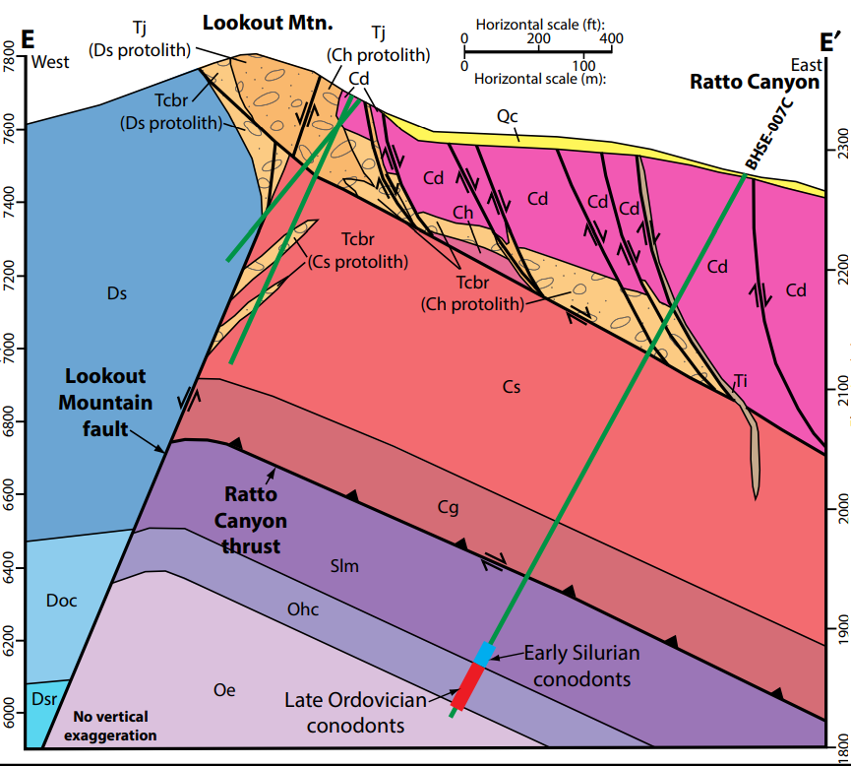
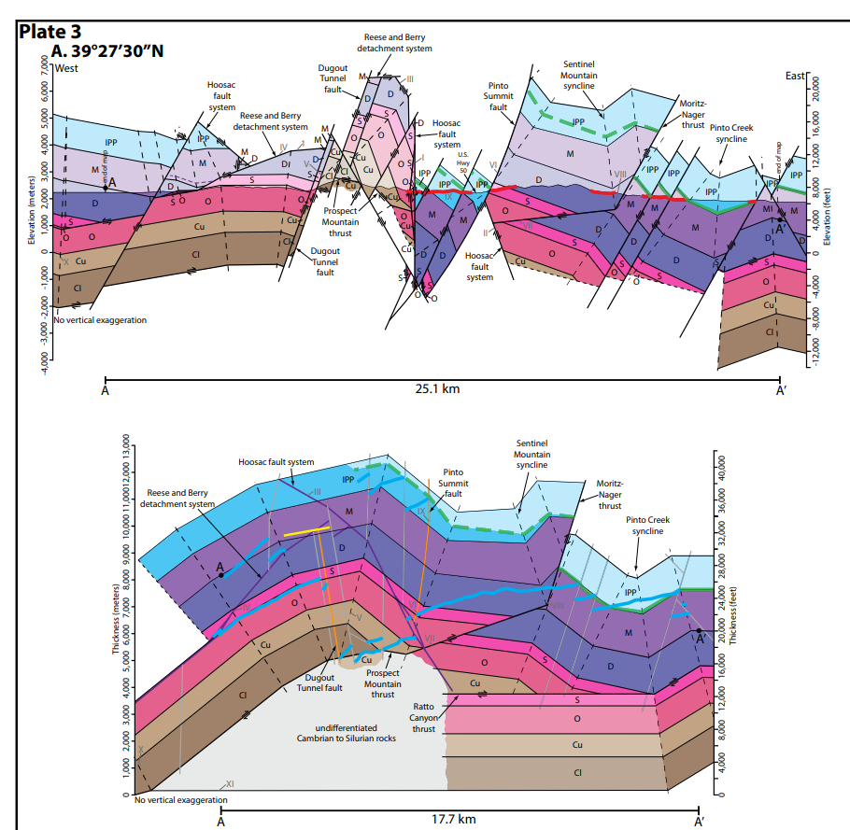
Sevier Hinterland
Sevier thrusts breach the surface in the Central Nevada Thrust Belt.
Good examples in the Eureka district.
Eureka culmination is a 20km wide, 4.5 km tall anticline interpreted to have resulted from 9km of slip along Ratto Canyon thrust.
Postdates Sevier by ~10-30 My
From Long (2014)

Slide 13
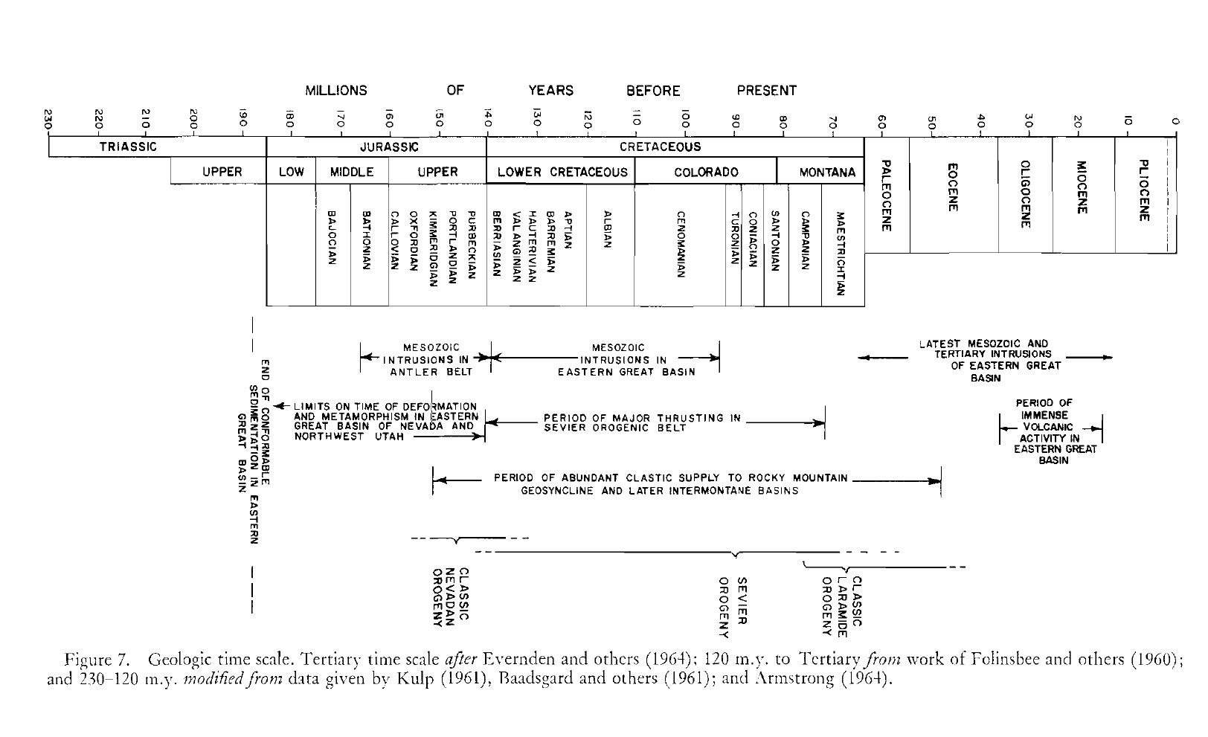
The frontal Sevier orogenic belt developed from the late Jurassic to late Cretaceous in western Utah and south-eastern Nevada.
It is now considered a classic example of thin-skinned thrusting
West of the frontal belt, the orogeny coincides with zones of folding, thrusting, and plutonism in the central and eastern Great Basin (Sevier Hinterland)

